Slide 1


Netflix & Chill – Project 1: Netflix Genres Analysis 2022 Georgia Tech Data Bootcamp August 2, 2022
Brian Hall | Daulton Davis | Hassan Mohamed
Joseph Johnson | Kelly Brown
Leon Lee | Orlvertta Moody
Valentina Zhu | Vedrana Basimamovic
This Photo by Unknown author is licensed under CC BY-ND.

Slide 2
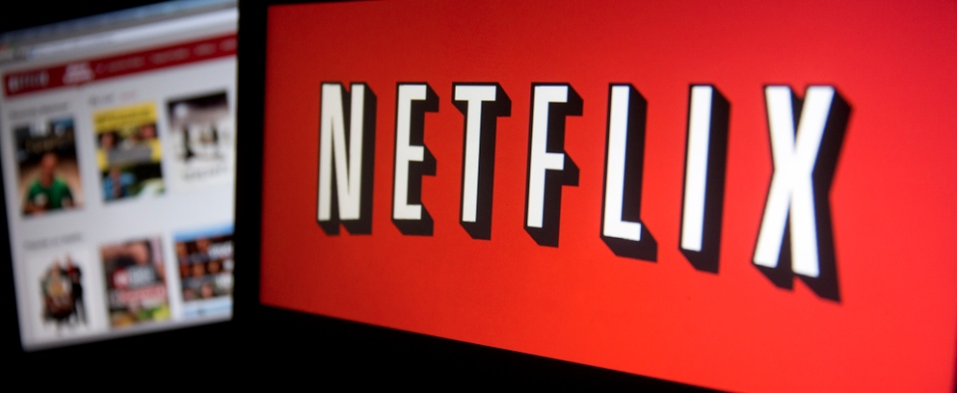
Overview
Netflix leaders are evaluating where to invest money for new content on Netflix.
They have requested an analysis of movies and shows that have previously aired on Netflix, in the following genres:
Action
Comedy
Documentary
Horror

Slide 3
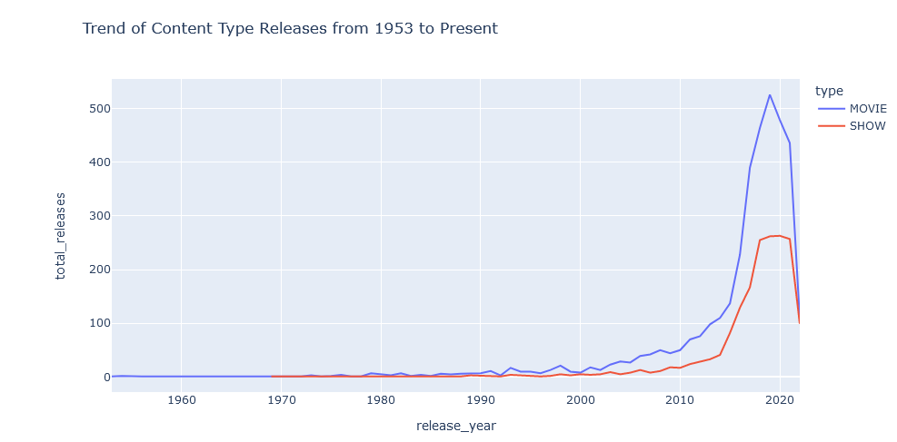
Analysis of genreS
For each genre, this team has been asked to determine the answers for:
Quantity of movies and shows
Quality of movies and shows
(IMDb average rating)
Most popular movie and/or show
(TMDb popularity rating)
Most featured actor
Note: The sample data used for each genre varied based on the number of titles per genre.

Slide 4
Dataset USED for analysis
Netflix TV Shows and Movies - Movies and TV Shows listings on Netflix – created by Victor Soeiro and posted on Kaggle.com
This dataset consists of all current movie and tv show listings on Netflix in the United States as of June 2022.
The dataset was created by accessing the Justwatch.com data API.
Justwatch.com uses data from IMDb and TMDb for their consumer site.
The dataset consists of two files. One contains the movie and tv show titles (titles.csv) and the other has the talent (e.g., actors, directors) of each title (credits.csv.)

Slide 5
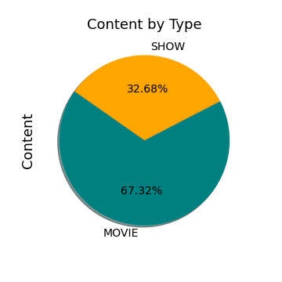
Dataset summary
The dataset has +5k unique titles recently available to stream on Netflix.
Approximately 2/3 of the data is for Movies.
The titles cover almost 70 years of tv and film with release dates from 1953 to 2022.
IMDb Ratings – min 1.5/max 9.5
TMDb Popularity scores min .6/max 1823.34
Notes:
IMDb Ratings
IMDb takes all individual ratings cast by IMDb registered users and use them to calculate a single rating.
The rating displayed on a title's page is a weighted average.
To display the detailed votes breakdown, click the number of votes located directly below the average IMDb user rating. For an example, see the User rating breakdown for Inside Out.
The IMDb weighted average does not change upon receipt of each new vote, but instead is updated numerous times per day.
A TV series rating is not the weighted average of the ratings of individual episodes. Instead, customers vote separately for the rating of the series as a whole via each title's series page.
IMDb doesn’t use the arithmetic mean (i.e. the sum of all votes divided by the number of votes for this number) for the weighted average, but do display the mean and average votes on the votes breakdown page.
TMDB – Popularity Score
(Items Bolded, Italicized and Underlined are unique to that content type)
Movies
Number of votes for the day
Number of views for the day
Number of users who marked it as a "favourite" for the day
Number of users who added it to their "watchlist" for the day
Release date
Number of total votes
Previous days score
TV Shows
Number of votes for the day
Number of views for the day
Number of users who marked it as a "favourite" for the day
Number of users who added it to their "watchlist" for the day
Next/last episode to air date
Number of total votes
Previous days score

Slide 6
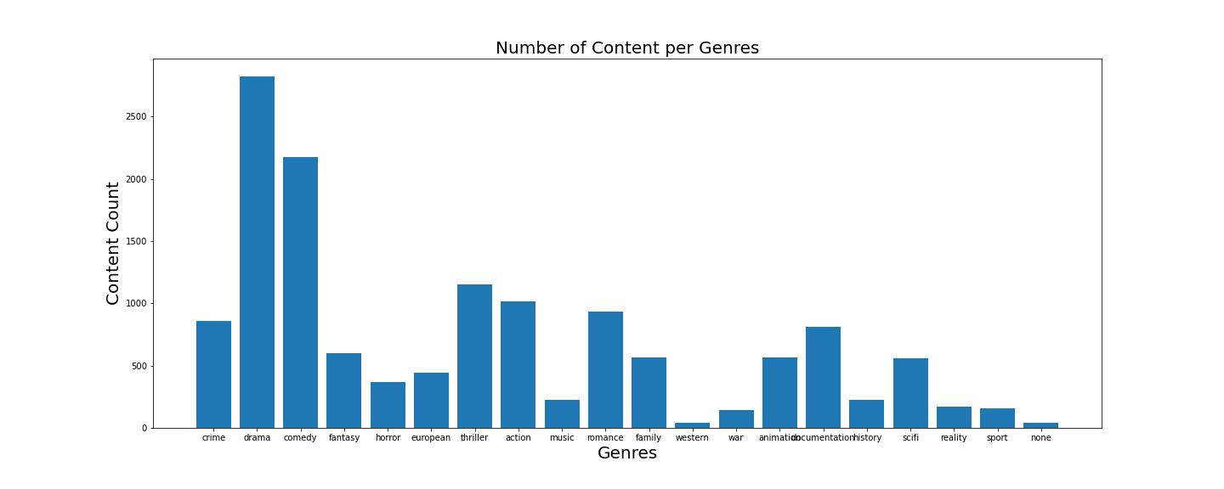
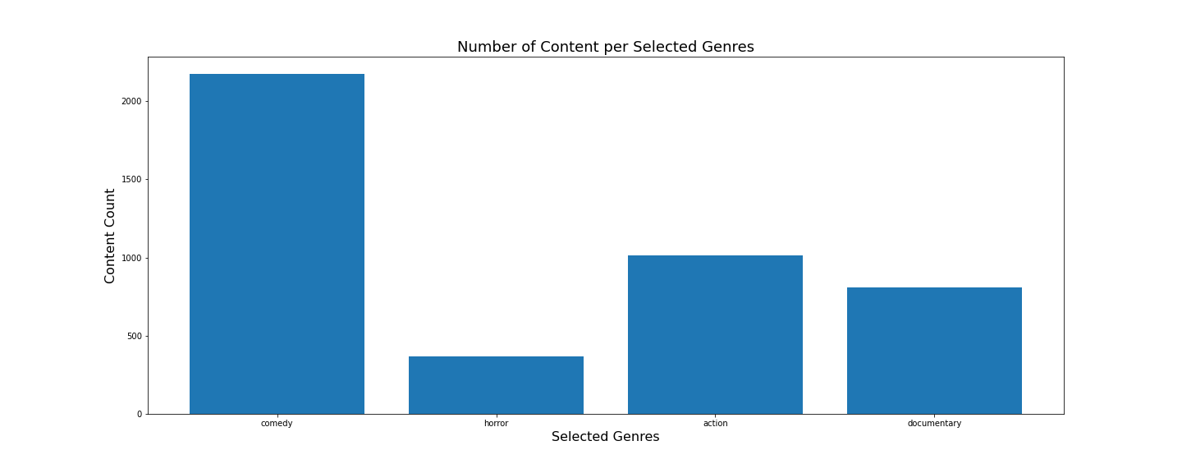
Overall Top 5 Genres
Drama
Comedy
Thriller
Action
Romance
Selected Genres % of Content
Comedy 40%
Action 19%
Documentary 15%
Horror 7%

Slide 7

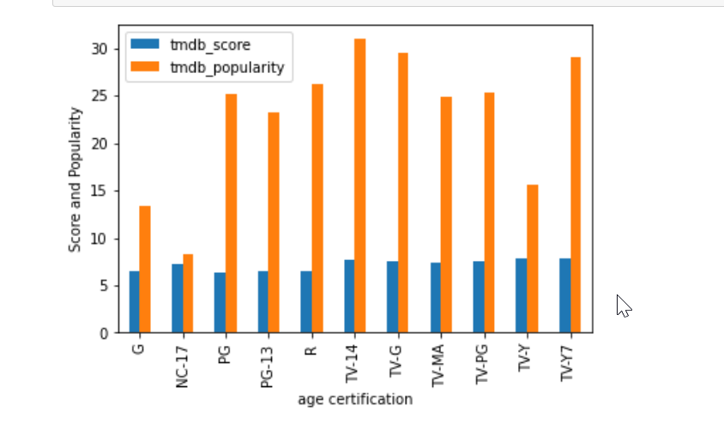
Comedy Findings
Highest TMDB/popularity scores based on rating categories for Movies: R, PG
Highest TMDB/popularity scores based on age certification categories for TV Shows: TV14, TV-G, & TV-Y7 (kids)
Notes:
TMDB – the movie database popularity score :
Number of votes for the day, views for the day, sers who marked it as a "favourite" for the day, users who added it to their "watchlist" for the day, release date, number of total votes, previous days score
IMDb Ratings
IMDb takes all individual ratings cast by IMDb registered users and use them to calculate a single rating.
The rating displayed on a title's page is a weighted average.
To display the detailed votes breakdown, click the number of votes located directly below the average IMDb user rating. For an example, see the User rating breakdown for Inside Out.
The IMDb weighted average does not change upon receipt of each new vote, but instead is updated numerous times per day.
A TV series rating is not the weighted average of the ratings of individual episodes. Instead, customers vote separately for the rating of the series as a whole via each title's series page.
IMDb doesn’t use the arithmetic mean (i.e. the sum of all votes divided by the number of votes for this number) for the weighted average, but do display the mean and average votes on the votes breakdown page.
TMDB – Popularity Score
(Items Bolded, Italicized and Underlined are unique to that content type)
Movies
Number of votes for the day
Number of views for the day
Number of users who marked it as a "favourite" for the day
Number of users who added it to their "watchlist" for the day
Release date
Number of total votes
Previous days score
TV Shows
Number of votes for the day
Number of views for the day
Number of users who marked it as a "favourite" for the day
Number of users who added it to their "watchlist" for the day
Next/last episode to air date
Number of total votes
Previous days score

Slide 8
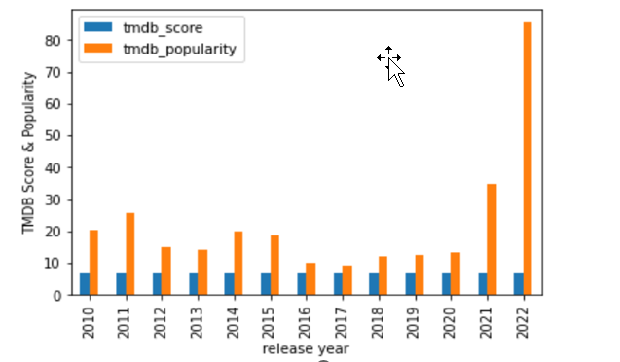
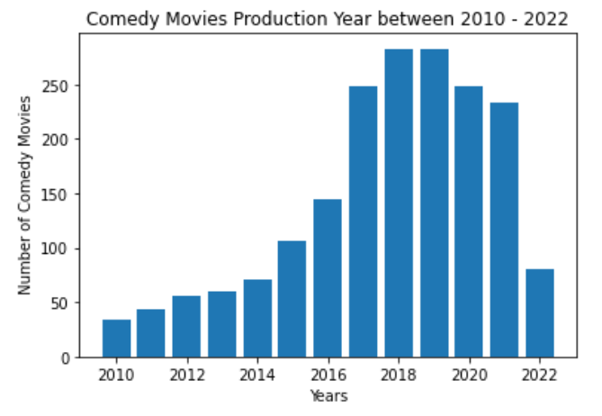

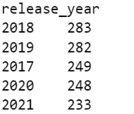
Comedy Findings, cont.
The highest number of movies recently available on Netflix were released between 2018 & 2019.
The highest TMDb Popularity scores are in 2022 .
It is interesting to note that the average TMDb score was between 6.5 and 6.7 for 2010 – 2022.
Notes:
TMDB – the movie database popularity score :
Number of votes for the day, views for the day, users who marked it as a "favourite" for the day, users who added it to their "watchlist" for the day, release date, number of total votes, previous days score
IMDb Ratings
IMDb takes all individual ratings cast by IMDb registered users and use them to calculate a single rating.
The rating displayed on a title's page is a weighted average.
To display the detailed votes breakdown, click the number of votes located directly below the average IMDb user rating. For an example, see the User rating breakdown for Inside Out.
The IMDb weighted average does not change upon receipt of each new vote, but instead is updated numerous times per day.
A TV series rating is not the weighted average of the ratings of individual episodes. Instead, customers vote separately for the rating of the series as a whole via each title's series page.
IMDb doesn’t use the arithmetic mean (i.e. the sum of all votes divided by the number of votes for this number) for the weighted average, but do display the mean and average votes on the votes breakdown page.
TMDB – Popularity Score
(Items Bolded, Italicized and Underlined are unique to that content type)
Movies
Number of votes for the day
Number of views for the day
Number of users who marked it as a "favourite" for the day
Number of users who added it to their "watchlist" for the day
Release date
Number of total votes
Previous days score
TV Shows
Number of votes for the day
Number of views for the day
Number of users who marked it as a "favourite" for the day
Number of users who added it to their "watchlist" for the day
Next/last episode to air date
Number of total votes
Previous days score

Slide 9


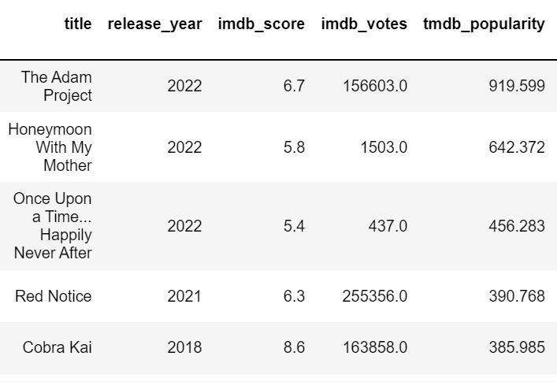
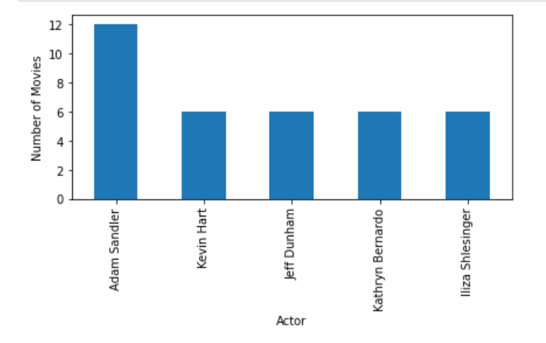
Comedy Findings, cont.
Most Popular Movie/TV Show:
The Adam Project
Most Featured Actor:
Adam Sandler
Notes:
TMDB – the movie database popularity score :
Number of votes for the day, views for the day, users who marked it as a "favourite" for the day, users who added it to their "watchlist" for the day, release date, number of total votes, previous days score
IMDb Ratings
IMDb takes all individual ratings cast by IMDb registered users and use them to calculate a single rating.
The rating displayed on a title's page is a weighted average.
To display the detailed votes breakdown, click the number of votes located directly below the average IMDb user rating. For an example, see the User rating breakdown for Inside Out.
The IMDb weighted average does not change upon receipt of each new vote, but instead is updated numerous times per day.
A TV series rating is not the weighted average of the ratings of individual episodes. Instead, customers vote separately for the rating of the series as a whole via each title's series page.
IMDb doesn’t use the arithmetic mean (i.e. the sum of all votes divided by the number of votes for this number) for the weighted average, but do display the mean and average votes on the votes breakdown page.
TMDB – Popularity Score
(Items Bolded, Italicized and Underlined are unique to that content type)
Movies
Number of votes for the day
Number of views for the day
Number of users who marked it as a "favourite" for the day
Number of users who added it to their "watchlist" for the day
Release date
Number of total votes
Previous days score
TV Shows
Number of votes for the day
Number of views for the day
Number of users who marked it as a "favourite" for the day
Number of users who added it to their "watchlist" for the day
Next/last episode to air date
Number of total votes
Previous days score

Slide 10

Action Findings
Action Dataset | #
Total # of Action Movies/TV Shows | 1053
Range of Years Movies/TV Shows were Released | 1956-2022
Number of Action Movies | 641
Number of Action TV Shows | 412
Average IMDb score | 6.45738025
This Photo by Unknown Author is licensed under CC BY-NC
Notes:
TMDB – the movie database popularity score :
Number of votes for the day, views for the day, users who marked it as a "favourite" for the day, users who added it to their "watchlist" for the day, release date, number of total votes, previous days score
IMDb Ratings
IMDb takes all individual ratings cast by IMDb registered users and use them to calculate a single rating.
The rating displayed on a title's page is a weighted average.
To display the detailed votes breakdown, click the number of votes located directly below the average IMDb user rating. For an example, see the User rating breakdown for Inside Out.
The IMDb weighted average does not change upon receipt of each new vote, but instead is updated numerous times per day.
A TV series rating is not the weighted average of the ratings of individual episodes. Instead, customers vote separately for the rating of the series as a whole via each title's series page.
IMDb doesn’t use the arithmetic mean (i.e. the sum of all votes divided by the number of votes for this number) for the weighted average, but do display the mean and average votes on the votes breakdown page.
TMDB – Popularity Score
(Items Bolded, Italicized and Underlined are unique to that content type)
Movies
Number of votes for the day
Number of views for the day
Number of users who marked it as a "favourite" for the day
Number of users who added it to their "watchlist" for the day
Release date
Number of total votes
Previous days score
TV Shows
Number of votes for the day
Number of views for the day
Number of users who marked it as a "favourite" for the day
Number of users who added it to their "watchlist" for the day
Next/last episode to air date
Number of total votes
Previous days score

Slide 11

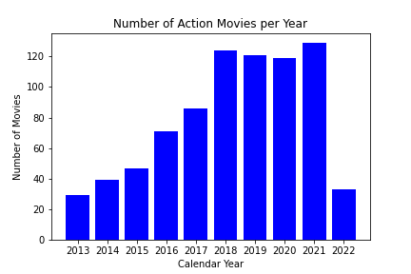
Action Findings, cont.
The number of action movies on Netflix had a steady growth and then had its biggest jump in 2018 (27.7%).
The significant drop for 2022 was due to the timing of the data (partway through 2022), so not all movies were accounted for in 2022.
Notes:
TMDB – the movie database popularity score :
Number of votes for the day, views for the day, users who marked it as a "favourite" for the day, users who added it to their "watchlist" for the day, release date, number of total votes, previous days score
IMDb Ratings
IMDb takes all individual ratings cast by IMDb registered users and use them to calculate a single rating.
The rating displayed on a title's page is a weighted average.
To display the detailed votes breakdown, click the number of votes located directly below the average IMDb user rating. For an example, see the User rating breakdown for Inside Out.
The IMDb weighted average does not change upon receipt of each new vote, but instead is updated numerous times per day.
A TV series rating is not the weighted average of the ratings of individual episodes. Instead, customers vote separately for the rating of the series as a whole via each title's series page.
IMDb doesn’t use the arithmetic mean (i.e. the sum of all votes divided by the number of votes for this number) for the weighted average, but do display the mean and average votes on the votes breakdown page.
TMDB – Popularity Score
(Items Bolded, Italicized and Underlined are unique to that content type)
Movies
Number of votes for the day
Number of views for the day
Number of users who marked it as a "favourite" for the day
Number of users who added it to their "watchlist" for the day
Release date
Number of total votes
Previous days score
TV Shows
Number of votes for the day
Number of views for the day
Number of users who marked it as a "favourite" for the day
Number of users who added it to their "watchlist" for the day
Next/last episode to air date
Number of total votes
Previous days score

Slide 12

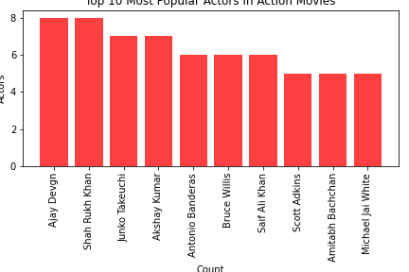
Action Findings, cont.
The most featured actors in action movies are international actors, which could represent Netflix’s desire to incorporate more international films.
There will have to be more data munging to figure if this is the case.
Notes:
TMDB – the movie database popularity score :
Number of votes for the day, views for the day, users who marked it as a "favourite" for the day, users who added it to their "watchlist" for the day, release date, number of total votes, previous days score
IMDb Ratings
IMDb takes all individual ratings cast by IMDb registered users and use them to calculate a single rating.
The rating displayed on a title's page is a weighted average.
To display the detailed votes breakdown, click the number of votes located directly below the average IMDb user rating. For an example, see the User rating breakdown for Inside Out.
The IMDb weighted average does not change upon receipt of each new vote, but instead is updated numerous times per day.
A TV series rating is not the weighted average of the ratings of individual episodes. Instead, customers vote separately for the rating of the series as a whole via each title's series page.
IMDb doesn’t use the arithmetic mean (i.e. the sum of all votes divided by the number of votes for this number) for the weighted average, but do display the mean and average votes on the votes breakdown page.
TMDB – Popularity Score
(Items Bolded, Italicized and Underlined are unique to that content type)
Movies
Number of votes for the day
Number of views for the day
Number of users who marked it as a "favourite" for the day
Number of users who added it to their "watchlist" for the day
Release date
Number of total votes
Previous days score
TV Shows
Number of votes for the day
Number of views for the day
Number of users who marked it as a "favourite" for the day
Number of users who added it to their "watchlist" for the day
Next/last episode to air date
Number of total votes
Previous days score

Slide 13

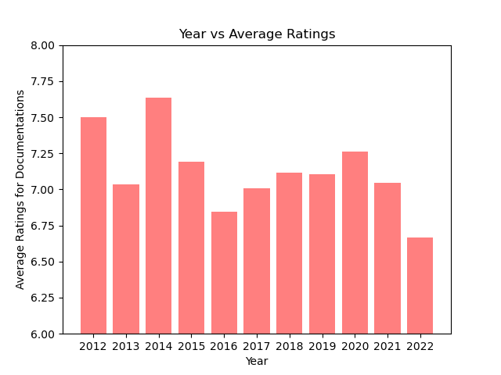
Documentary Findings
Total count of documentaries: 1688/10179
Genre of documentary makes up around 16% of movie and tv show mark
From year 2012 to year 2022, ratings for documentaries have been fluctuating with a peak in year 2014.
Average IMDB rating for documentaries is 7.13, which is comparatively higher than other genres.
Notes:
TMDB – the movie database popularity score :
Number of votes for the day, views for the day, sers who marked it as a "favourite" for the day, users who added it to their "watchlist" for the day, release date, number of total votes, previous days score

Slide 14
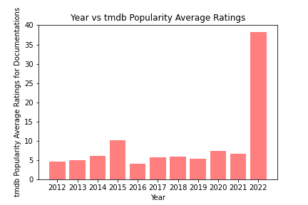
Documentary Findings
From year 2012 to year 2022, ratings for documentaries have been fluctuating with a peak in year 2022 when it comes to tmdb popularity rating.
Average tmdb popularity rating for documentaries is 9.0199
Higher popularity with movies vs shows
Notes:
TMDB – the movie database popularity score :
Number of votes for the day, views for the day, sers who marked it as a "favourite" for the day, users who added it to their "watchlist" for the day, release date, number of total votes, previous days score

Slide 15

Horror Findings
Horror Dataset | #
Total # of Horror Movies/TV Shows | 374
Range of Years Movies/TV Shows were Released | 1973-2022
Average IMDb score | 6.0
Highest IMDb Rated Title | Attack on Titan
Top Featured Actor in Horror Titles | Yuki Kaji
Notes:
TMDB – the movie database popularity score :
Number of votes for the day, views for the day, sers who marked it as a "favourite" for the day, users who added it to their "watchlist" for the day, release date, number of total votes, previous days score

Slide 16
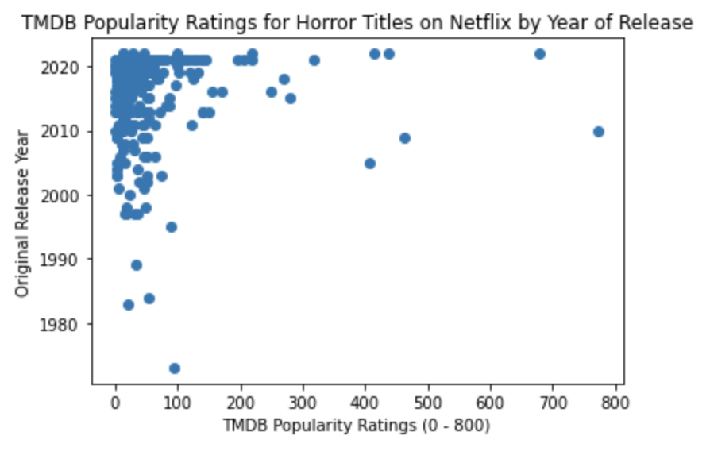


HORROR Findings, cont.
Most Popular Horror Title:
The
Walking
Dead
2010
TMDb Popularity Rating:773.19
TMDb Average Rating: 43.13
Notes:
The top 10 titles – Two are Netflix Originals – Texas Chainsaw Massacre 2022 437.842, Stranger things 2016 249.853
Top 10 range: 773.19 – 249.85d3
TMDB – the movie database popularity score :
Number of votes for the day, views for the day, users who marked it as a "favourite" for the day, users who added it to their "watchlist" for the day, release date, number of total votes, previous days score
IMDb Ratings
IMDb takes all individual ratings cast by IMDb registered users and use them to calculate a single rating.
The rating displayed on a title's page is a weighted average.
To display the detailed votes breakdown, click the number of votes located directly below the average IMDb user rating. For an example, see the User rating breakdown for Inside Out.
The IMDb weighted average does not change upon receipt of each new vote, but instead is updated numerous times per day.
A TV series rating is not the weighted average of the ratings of individual episodes. Instead, customers vote separately for the rating of the series as a whole via each title's series page.
IMDb doesn’t use the arithmetic mean (i.e. the sum of all votes divided by the number of votes for this number) for the weighted average, but do display the mean and average votes on the votes breakdown page.
TMDB – Popularity Score
(Items Bolded, Italicized and Underlined are unique to that content type)
Movies
Number of votes for the day
Number of views for the day
Number of users who marked it as a "favourite" for the day
Number of users who added it to their "watchlist" for the day
Release date
Number of total votes
Previous days score
TV Shows
Number of votes for the day
Number of views for the day
Number of users who marked it as a "favourite" for the day
Number of users who added it to their "watchlist" for the day
Next/last episode to air date
Number of total votes
Previous days score

Slide 17
recommendations
Since Documentaries and Action genres have the highest imbd rating, we as a group would recommend adding more of these genres to hopefully gain popularity and more subscribers to Netflix.
For comedy: Produce or acquire more content that target TV-Y TV shows and G rated movies. Diversify content that contain actors that are outside the top 5, for example Adam Sandler or Kevin Heart.
For horror content, we recommend investing in shows versus the movies because the top content in count and popularity consisted of shows.
Notes:
TMDB – the movie database popularity score :
Number of votes for the day, views for the day, sers who marked it as a "favourite" for the day, users who added it to their "watchlist" for the day, release date, number of total votes, previous days score

